Slide 1
STUDENT RECORD KEEPING SYSTEM
Course Based Project on
Prepared By:
E Sai Sharan 17071A12D2
G Vijay Kumar 17071A12D3
G Sai Prudhvi 17071A12D4
G Aishwarya Varma 17071A12D5
K Hari Gopal 17071A12D6
Under the Guidance of
T.Ravi , Asst.professor
Dept. of Information Technology
VNR Vignana Jyothi Institute of Engineering & Technology

Slide 2
Objective :
The aim of this project is to build a student record keeping system that will completely automate the process of new student registration in a university.
The system will handle the details of the newly added record of a student.
The system will be offline based and it is not portable.
The records are saved in the hard disk of the computer and can be accessed anytime and can be updated.

Slide 3
Existing System :
The existing system of record keeping requires many documents and application forms to be filled out.
Data has to be repeatedly entered at each stage of the process and multiple files are made for each student.
Documents are verified with multiple copies made for record and the testing process is conducted independently which again compounds the paperwork required.
The amount of data processing required for each stage of the process ensures that the process of new student record keeping takes a long time.

Slide 4
Proposed System:
The proposed system will eliminate the paper trail required for the completion of record keeping.
The entire process of record keeping can be handled by this system. The existing records can be accessed anytime.
The presence of this system will remove ambiguity in the process that can confuse the person handling the record keeping.
This system makes it easy for the person who is handling the record keeping and also eliminates the ambiguity.

Slide 5
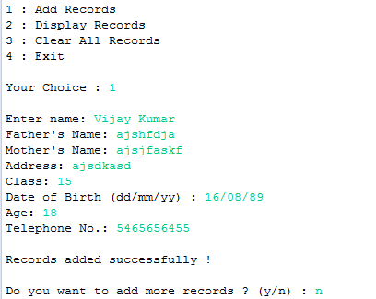
Modules:
Add Records:
Using this option we can add the newly added student records.
It takes the details of the student such as student name, Parents details, Date of birth and some other personal details of the student.
The records are stored in a file with in the location where the code is accessed.

Slide 6
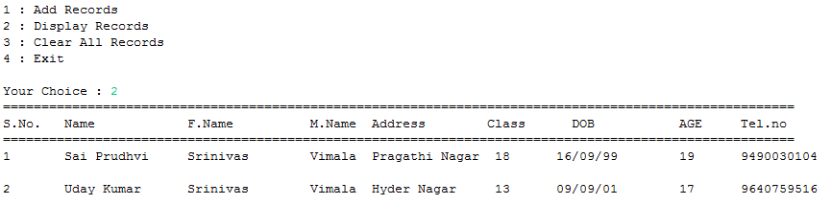
Modules ( contd ):
Display Records:
This displays the existing student details.
The details are taken from the file that was stored in the hard disk previously.
The details are showed in a tabular format.
The newly added records are saved automatically in the file and showed in the table.

Slide 7
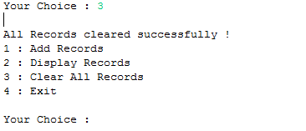
Modules ( contd ):
Clear All Records:
This option clears all the records that are previously stored in the file and makes a new file in the same location.
This option must be used with caution because it can clear all the records.
It is better to keep a backup of the file in the hard disk.

Slide 8
Modules ( contd ):
Exit:
This option exits the control from the console and returns to the command prompt.
This option doesn’t affect the record that has been updated and the previously added records can be again accessed by running the program.

Slide 9
The File :
A file is created in the given work space of the program
The file is in ( .txt) format
It can be open in note pad and can be shared with the management

Slide 10
Working on :
Deleting a particular record
Sorting of the records
Searching of records

Slide 11
Software Requirements
Windows XP/7/8/10
JDK (Running and updating the code) or JRE (Must for running the code)
Technology Used
Java
Hardware Requirements
Hard Disk – 100 GB
RAM – 1 GB
Processor – Dual Core or Above

Slide 12
Thank You

